Slide 1

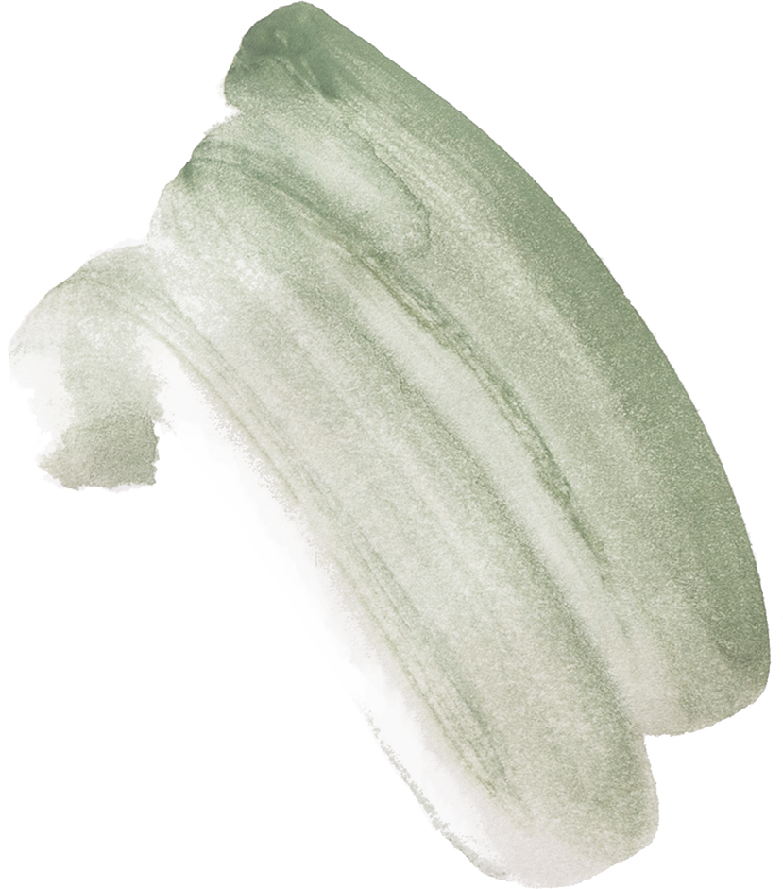

IMPLEMENTATION OF TONE-MAPPING ON FPGA
Akash Ranjan Sahu (24614), Girish R (24878), Mohammad Farukh Zafar (25047), Sourish Vijayamadhavan (24140)

Slide 2

MOTIVATION
HDR images have higher contrast compared to regular SDR images, due to the pixel representation (32-bit floating-point vs 8-bit integer per channel)
While viewing HDR images on devices supporting only SDR, truncation can be used - resulting in saturation of image
Most display devices that support only SDR implement tone-mapping algorithms to preserve the colour contrast of the original HDR image while representing it as 8-bit integer pixels

Slide 3
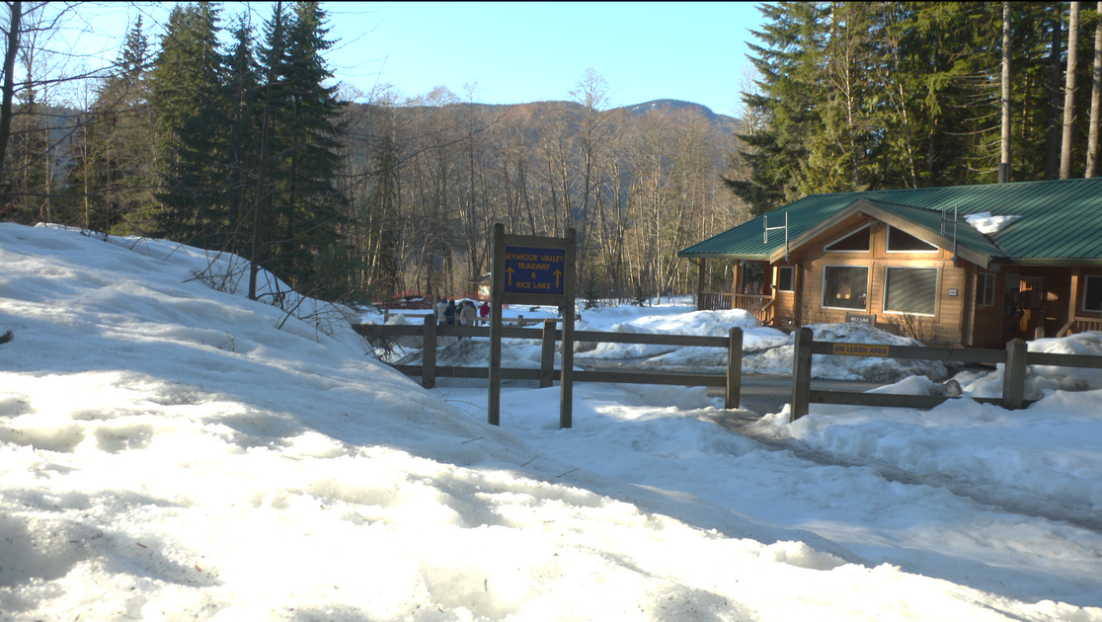
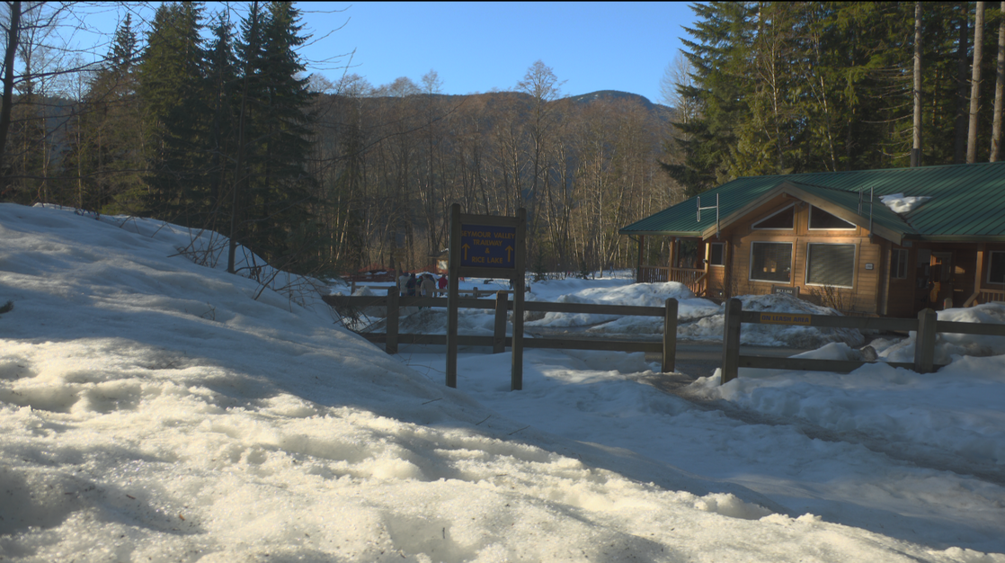
MOTIVATION
HDR Image Displayed on SDR Device
HDR Image Displayed on HDR Device

Slide 4
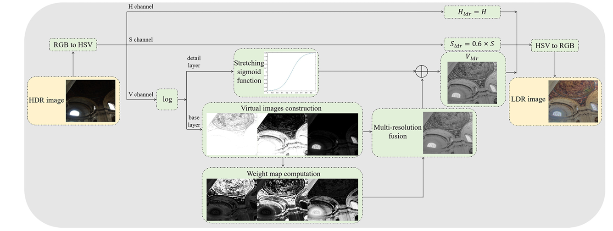
TONE-MAPPING ALGORITHM
The algorithm used for tone-mapping is as follows -

Slide 5
TONE-MAPPING ALGORITHM
The algorithm consists of the following steps -
Conversion of RGB image to HSV (Hue-Saturation-Value)
Logarithmic Compression of V channel
Gaussian Filtering of compressed V channel to obtain base layer - implemented on FPGA
Subtraction of base layer from compressed V channel to obtain detail layer
Thresholding to generate 3 virtual images from base layer
Perform Multi-resolution fusion
Contrast stretching on detail layer
Downscale saturation and convert HSV back to RGB

Slide 6
IMPLEMENTATION OF CONVOLUTION ON FPGA
The convolution of the log-compressed value channel is the most computationally expensive part, and can reduce the burden on the processor if implemented on the FPGA instead
The hardware implemented on FPGA consists of 2 modules -
UART Transceiver Module
Convolution Module

Slide 7
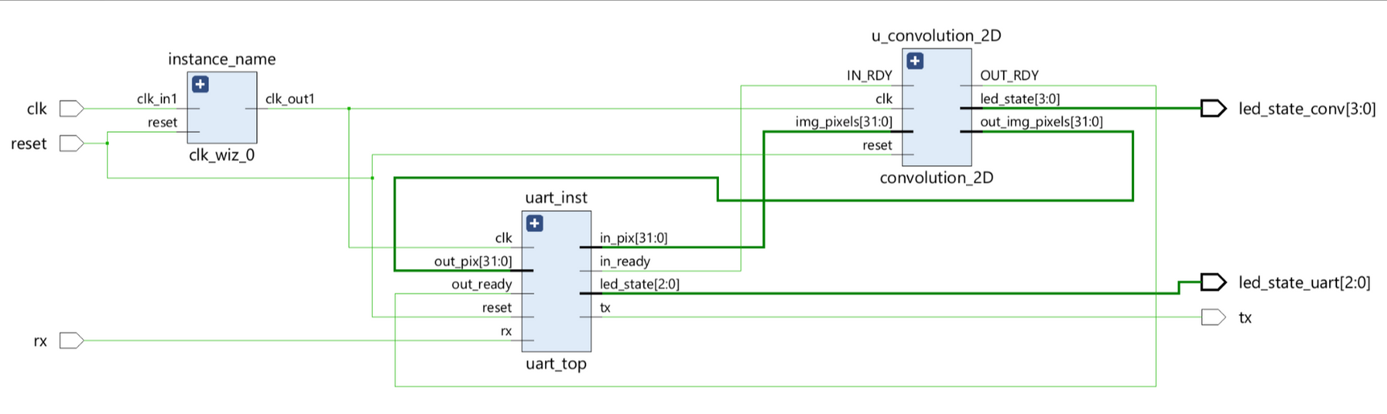
FPGA ARCHITECTURE

Slide 8
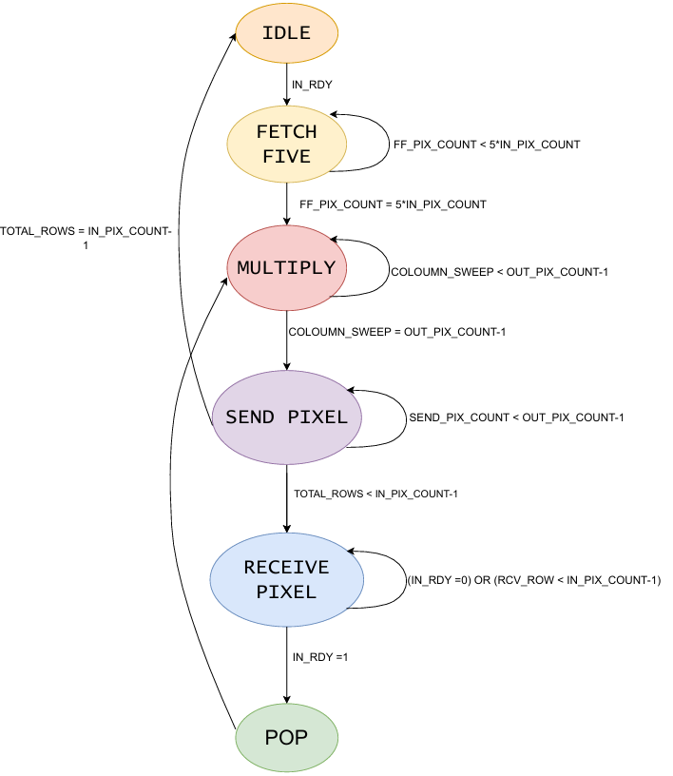
CONVOLUTION FSM

Slide 9
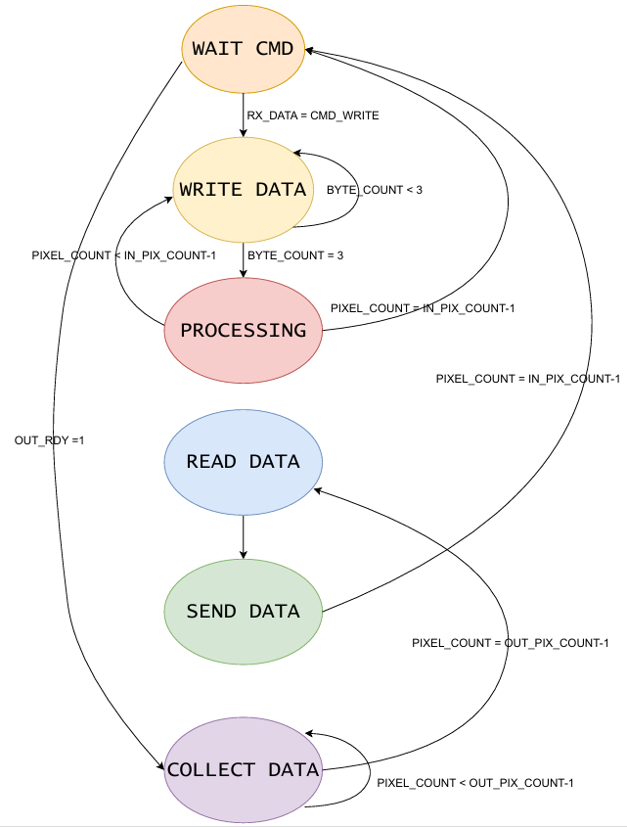
UART TRANSCEIVER FSM

Slide 10
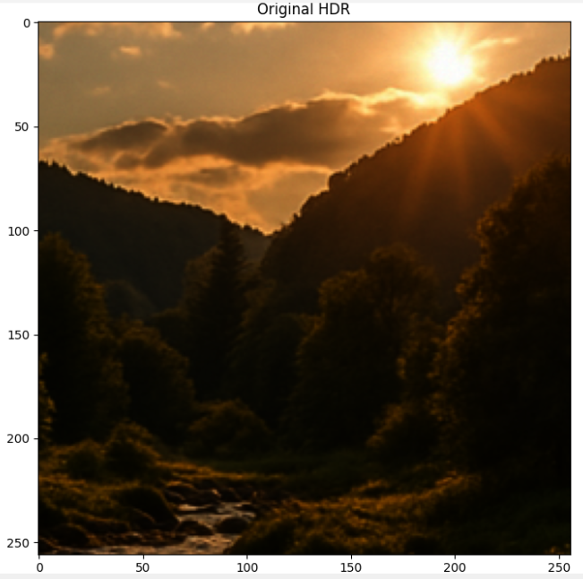
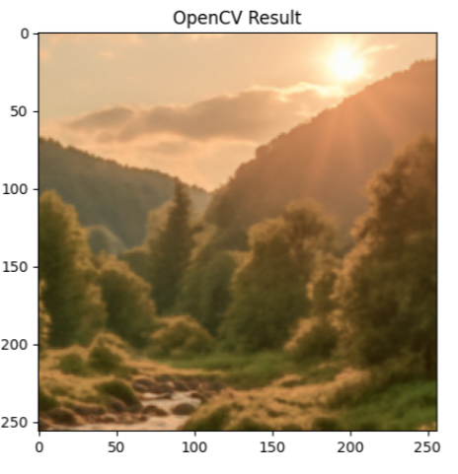
SOFTWARE IMPLEMENTATION OF TONE-MAPPING

Slide 11
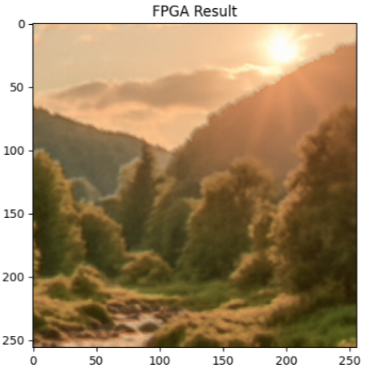
IMPLEMENTATION OF TONE-MAPPING ON FPGA

Slide 12
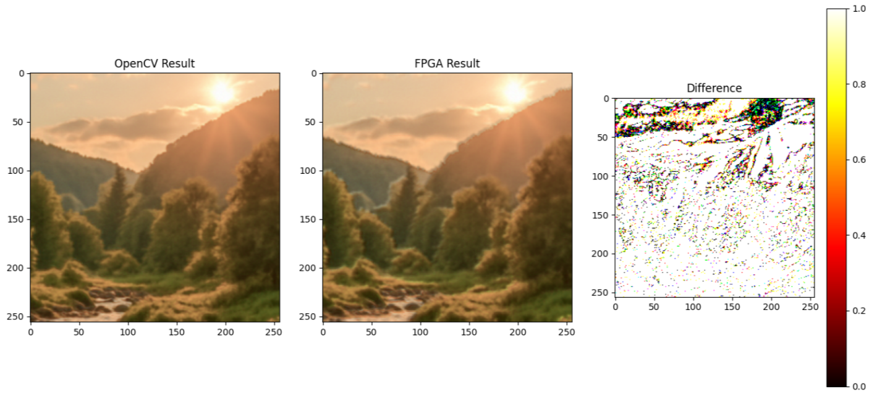
COMPARISON BETWEEN FPGA AND OPENCV IMPLEMENTATION
The tone-mapped SDR image has a TMQI (tone-mapped quality index) score of 0.79 - higher TMQI indicates better-quality tone-mapping

Slide 13
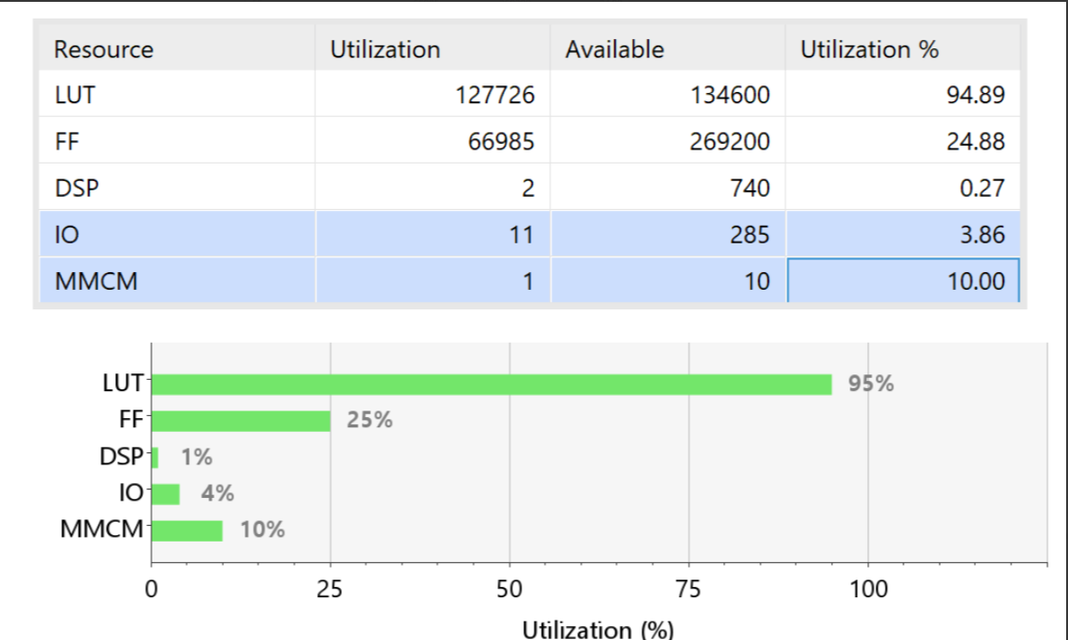
DESIGN SPECIFICATIONS
The convolution module for 256x256 image was implemented on the Nexys Video FPGA (Xilinx XC7A200T)
The resource utilization of the implemented design is as follows -

Slide 14
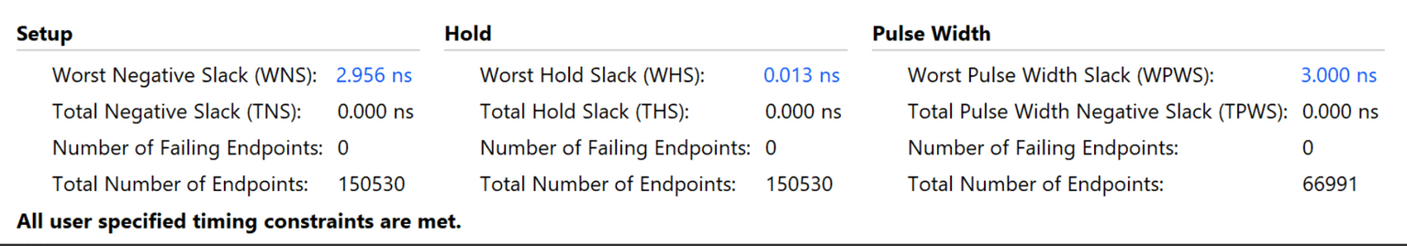
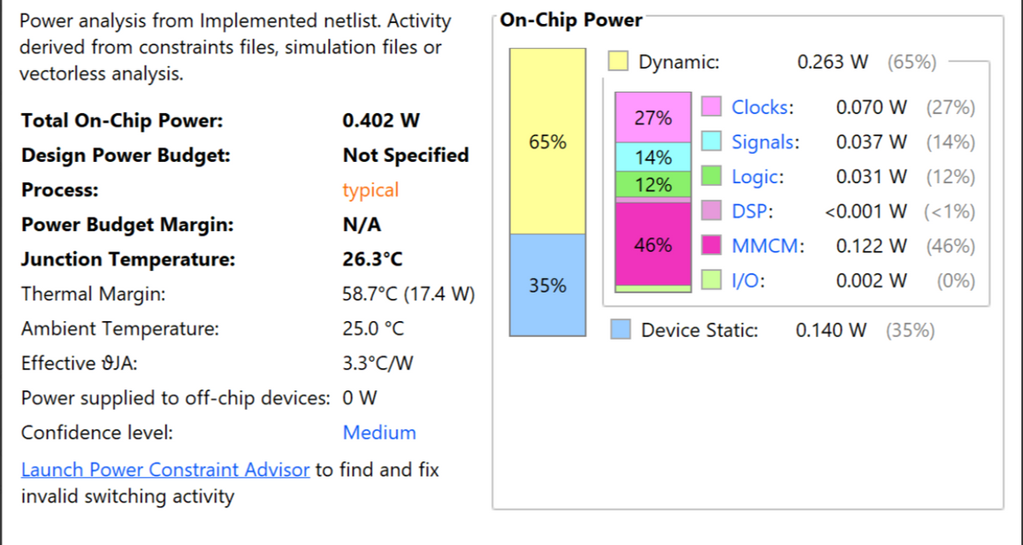
DESIGN SPECIFICATIONS
The timing and power analysis is given below (16 MHz system clock frequency)

Slide 15
DESIGN CONSIDERATIONS
The size of the value channel of the image is 256 kB, which cannot be stored directly on the Basys3 FPGA
A line buffer of 5 rows and 256 columns is instantiated, and convolution occurs on these 5 rows to generate a single output row, which is sent back to the PC over UART. We then receive the next row from the PC and pop the line buffer, continuing this process until all rows are received
The UART transceiver is configured to run at 115200 baud, which corresponds to 139 clock cycles for each bit (16 MHz clock). Higher UART speeds resulted in improper sampling
Hold violations were encountered in our design, which were solved by manually adding BUFG buffers along the data path

Slide 16
FUTURE SCOPE
Use Systolic Array to implement convolution as a modified form of vector matrix multiplication
Implementing other steps of the algorithm (thresholding, sigmoid stretching, log compression) on FPGA

Slide 17
REFERENCES
X. Han and S. Rahardja, "High Dynamic Range Image Tone Mapping Based on Layer Decomposition and Image Fusion," 2023 IEEE International Conference on Image Processing (ICIP), Kuala Lumpur, Malaysia, 2023, pp. 221-225.
T. Mertens, J. Kautz and F. V. Reeth, "Exposure Fusion: A Simple and Practical Alternative to High Dynamic Range Photography", Computer Graphics Forum, vol. 28, no. 1, pp. 161-171, Mar. 2009.

